Slide 1

FOREIGN DIRECT INVESTMENT ANALYSIS
KANURI PRANAY

Slide 2
OBJECTIVE
The goal of this project is to understand the Foreign direct investment in India for the last 17 years from 2000-01 to 2016-17.

Slide 3
PROBLEM STATEMENT
Investment is a game of understanding historic data of investment objects under different events but it is still a game of chances to minimize the risk we apply analytics to find the equilibrium investment.
To understand the Foreign direct investment in India for the last 17 years from 2000-01 to 2016-17. This dataset contains sector and financial year-wise data of FDI in India
Sector-wise investment analysis
Year-wise investment analysis

Slide 4

ARCHITECTURE
Real World
Data Pre-Processing
Raw Data Collection
Importing Libraries in Jupyter Notebook
Load Dataset
Missing Value Imputations
Handling Outliers
Data Cleaning
Deployment
Insights
Power BI Desktop
Modelling
Exploratory Data Analysis (EDA)
Reporting
Low-Level Design Document
High-Level Design Document
Architecture Document
Wireframe Document
Detailed Project Report

Slide 5
DATASET INFORMATION
This dataset contains sector-wise and financial year- wise data of FDI in India

Slide 6
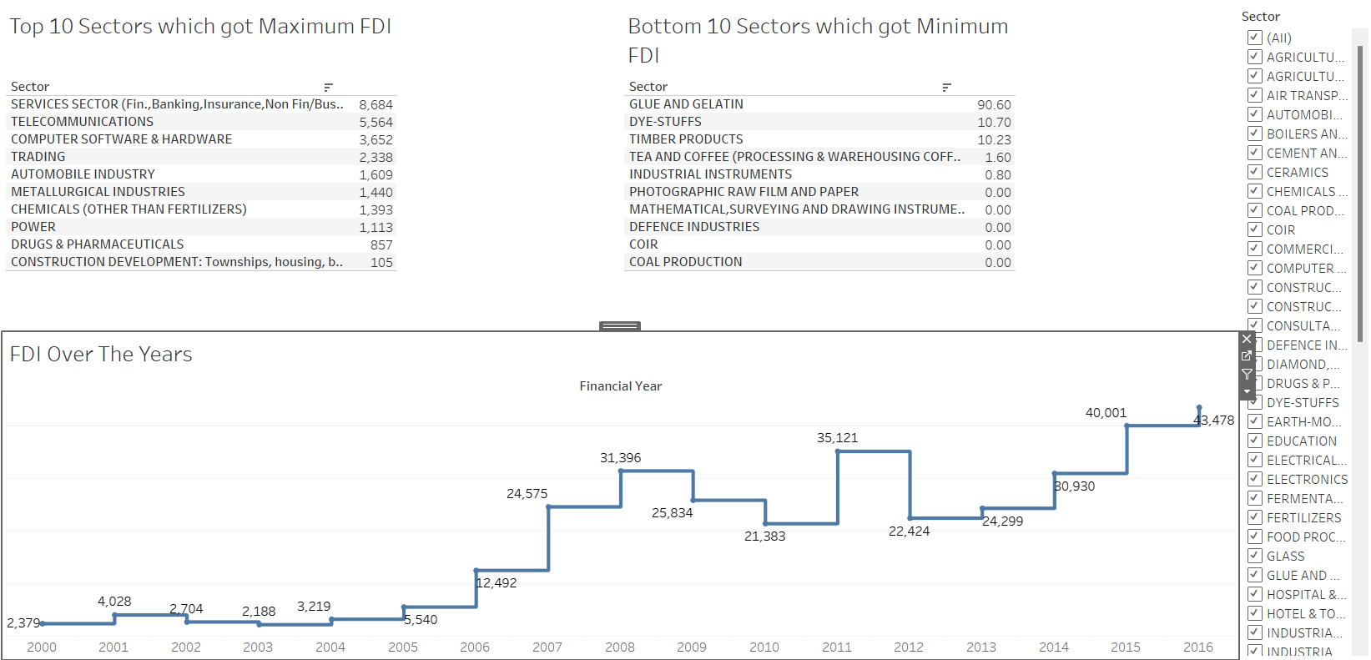
Service Sector received around 8.684 FDI from FY 2000-01 to FY 2016-17 which was the highest, details regarding other sectors are also available. From the Line-chart we can see the trend of FDI Over the Years.

Slide 7
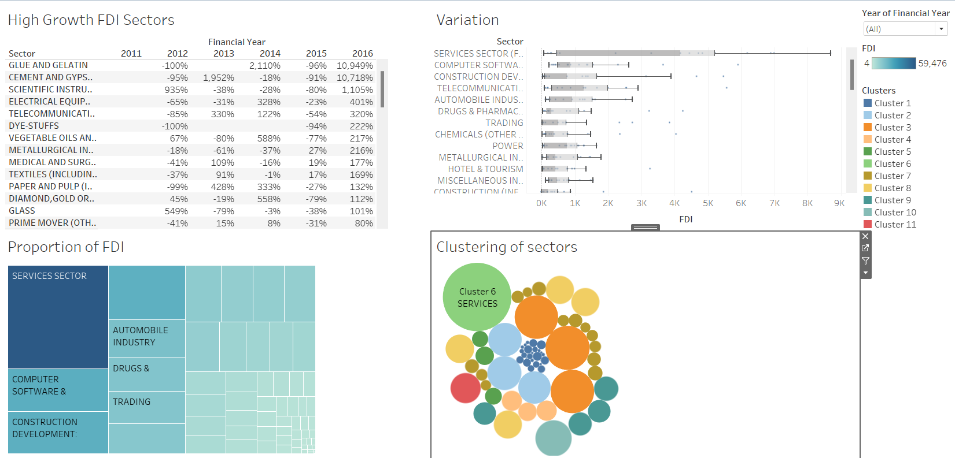
Glue And Gelatin has the highest growth in last five years with 10% followed by Cement. Service sector have the highest over growth in all 17 years.

Slide 8
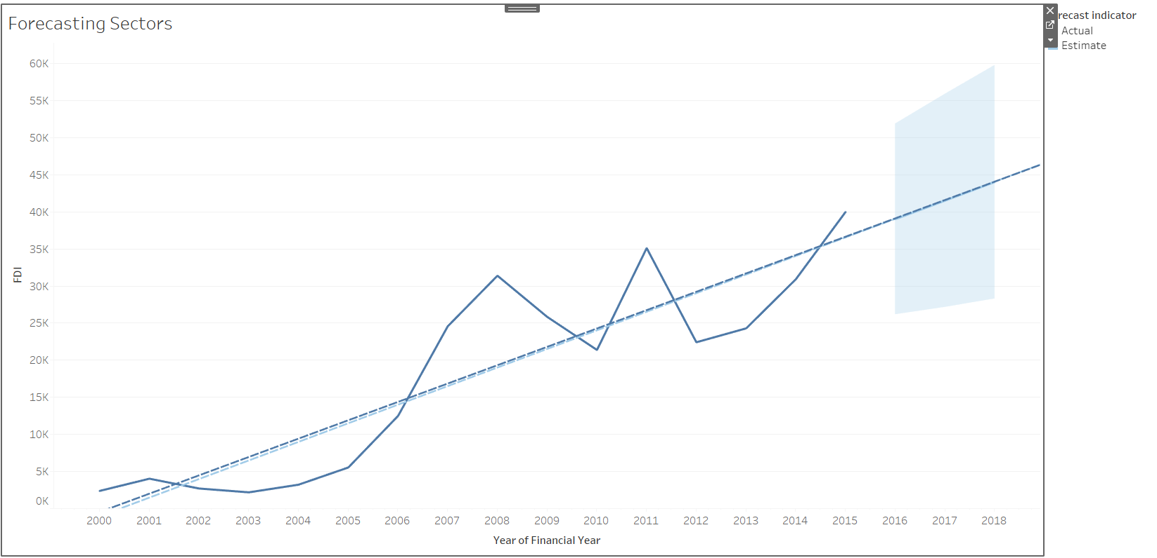
Forecasting the investments of all sectors of years 2017 and 2018.

Slide 9
CONCLUSION
SECTORAL COMPOSITION OF FDI:-
The Sectoral composition of FDI over the period of April 2000 to June 2017, we can find that the largest recipient of such investment is Service sector (Financial and non-financial services). The share of this sector comparing to all sector is 17.65 % of the inflow total foreign direct investment.
The foreign investors are interested in mainly financial services due to its profit generating advantage. This sector gives scope for the foreign investor to take back the profits to the home country. As service sector the services are consumed in the host country and there by generating outflow of funds from the host country.
The second recipient is Computer software and Hardware sector which shares 7.66% of total FDI. Construction development,
Telecommunication, Automobile Industry sector having 7.31%, 6.43%, 5.17% respectively.
The keys takeaways regarding global flows are – the increase in the relative share of developing countries as both destination and sources and flow to the sector gaining over manufacturing.
FY-wise GROWTH ANALYSIS:-
The total amount of FDI inflows in India during the last 17 years i.e. 2000 to 2017. The FDI inflow from 2000-2001 i.e. ₹9869.28Cr. in 2001-02 it was ₹17033.13Cr. It shows the Good result in the FDI inflows in India. Little bit ups and downs in FDI inflows up to 2005-06, but after that great hike in the year 2007-08 and FDI was ₹138973.91Cr. In 2008-2009 there was a huge investment in FDI in ₹200086.46Cr. But then there was a downfall in Inflow of FDI in two consecutive years 2009-2010 and 2010-2011, with figures 174227.03 and 129196.46 respectively. Year 2012-13 and 2013-14 the FDI inflow fluctuated from 154027.63 to 189874.87 respectively. We can analysis from the graph that in the year 2015-2016 the inflow of FDI was second highest of last 15 years i.e. 284647.06.In last Financial Year i.e.2016-2017 the amount of FDI Inflow were ₹291608.67Cr which is the highest FDI inflow in last 17 years.

Slide 10
THANK YOU

